Slide 1


Slide 2
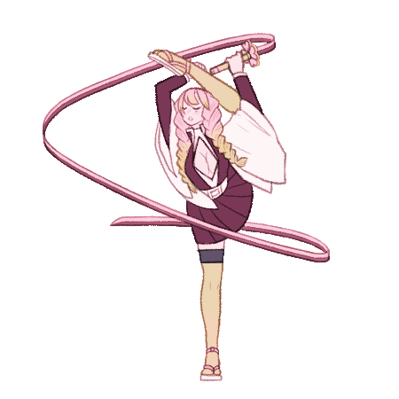
Rhythmic
Gymnastics

Slide 3

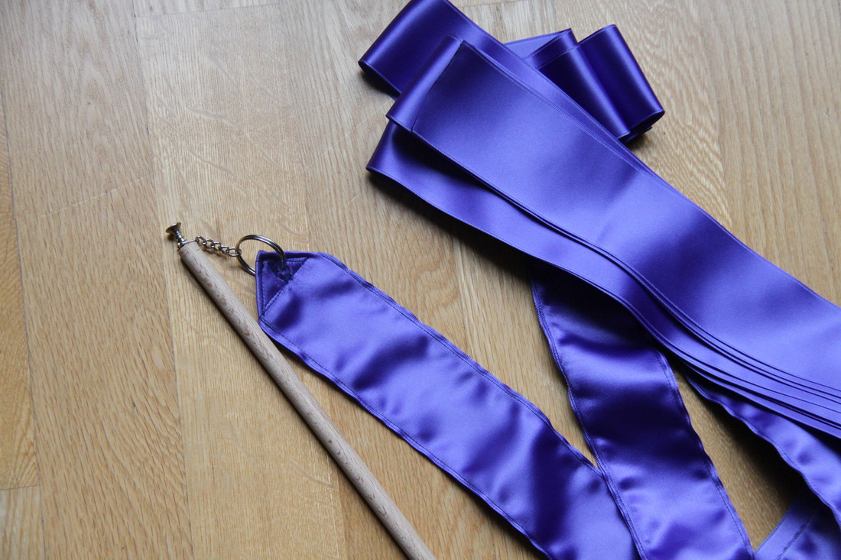




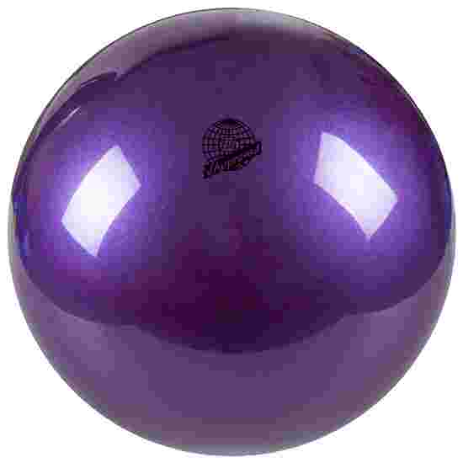
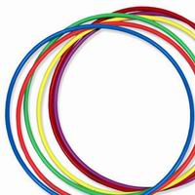
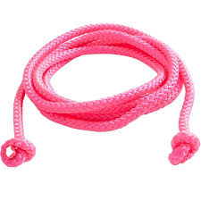
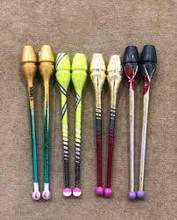
What Are the Apparatuses ?
BALL
RIBBON
HOOP
ROPE
CLUBS
MANAGE APPARATUS

Slide 4
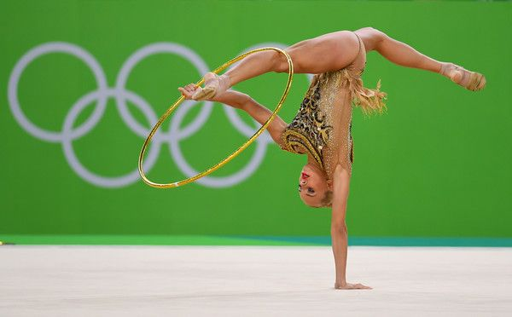








Rhythmic gymnastics
The sport provides the opportunity for gymnasts to express their own personality and expression, whilst learning new skills along the way, keeping them interested and active.
Rhythmic gymnastics
1 2 3 4 5

Slide 5

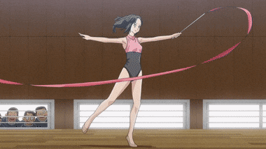
Rhythmic gymnastics
1
Rhythmic gymnastics is a sport that combines elements of ballet, gymnastics, dance, and apparatus manipulation. Individuals or teams of competitors (from 2 to 6 people) manipulate one or two pieces of apparatus: rope, clubs, hoop, ball, ribbon and Free (no apparatus, so called "floor routine").
It became an Olympic sport in 1984, with an individual all-around event. The group all-around competition was added to the Olympics in 1996. At the international level, rhythmic gymnastics is a women-only sport.
Rhythmic Gymnastics brings young girls quest for fun and creative outlet into the gym, in an environment where girls can develop in a social environment with their friends.
Rhythmic Gymnastics Part 1

Slide 6
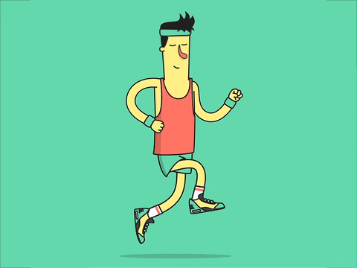
1
A. Warm up and Cool down Exercises
Importance of Warm-up Exercises -The main goal of warm up is to avoid injuries. Warming up your body is particularly important in preparation for gymnastic activities since this type of activity is physically demanding. Below are tips on how to do a good warm up exercise:
a. Jog in Place - start with a jog in place (approximately 5 mins) in your floor space. This the most simple cardio method of increasing your heart rate and therefore increasing blood circulation to your muscles.
Rhythmic Gymnastics Part 1

Slide 7
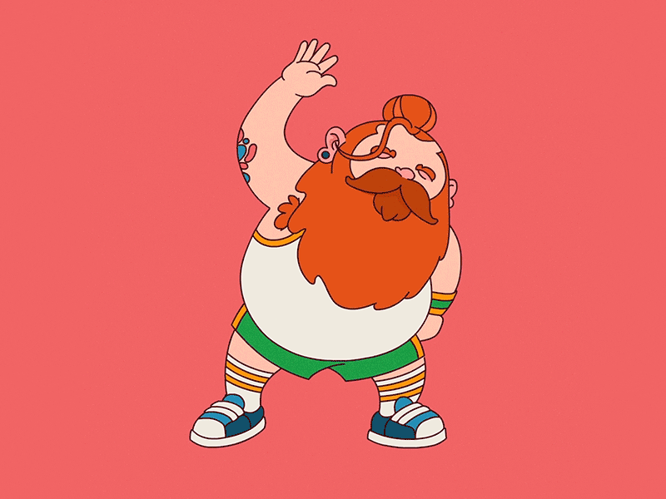
1
A. Warm up and Cool down Exercises
b. Proper Stretching- Make sure to target the body’s major joints:
Ankles
Wrists
Neck
Shoulders
Hips
Back
Legs
Rhythmic Gymnastics Part 1

Slide 8

1
A. Warm up and Cool down Exercises
2. Importance of Cool Down Exercises
- After being active in a gymnastics session, your muscles are still engaged, but fatigued and in need of recovery. Cool down exercises can help aid, recovery, and maintain good health after intensive training.
Gentle Exercise
- A slow jog in place for 5-10 minutes to slowly regulate heart and breathing rate.
Rhythmic Gymnastics Part 1

Slide 9
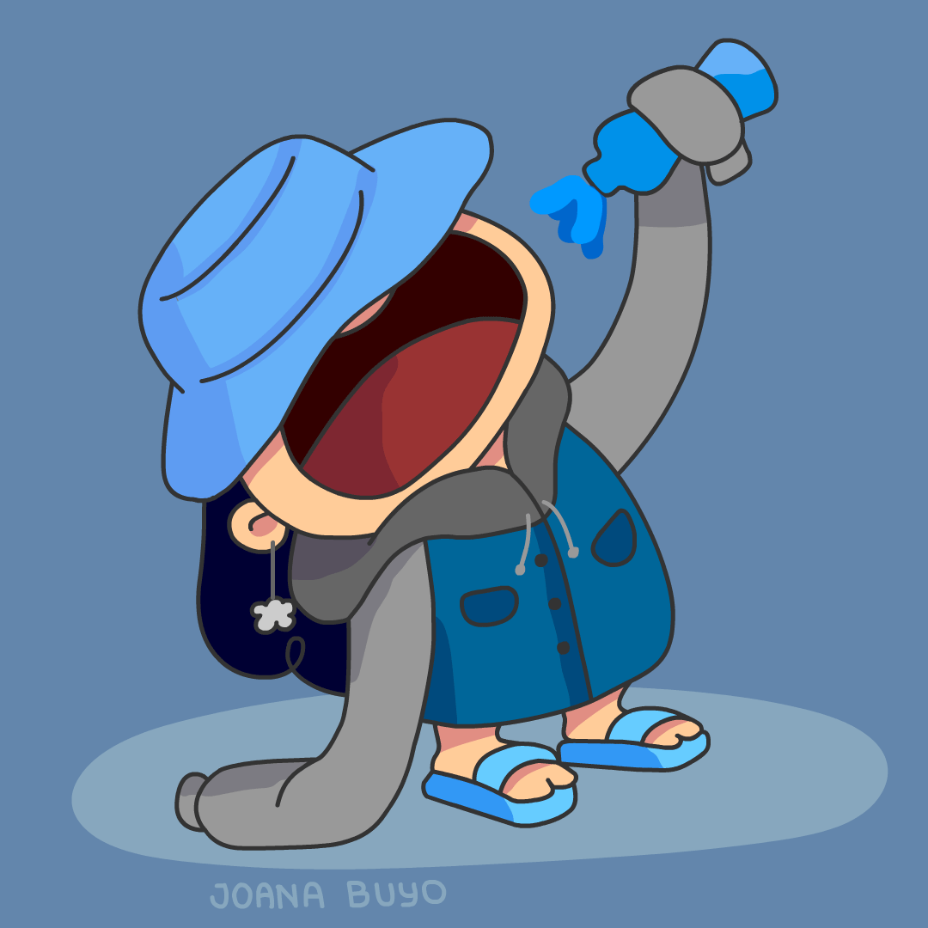
1
A. Warm up and Cool down Exercises
b. Stretching
- static stretching for 5-10 minutes can help decrease body temperature,mechanically force waste products (formed in the muscles during exercise) from the sarcomeres of the muscle to the blood due to high tension they generate, and increase the range of motion at the muscle. Pay special attention to stretching the muscles that were specifically strained during exercises, stretching them longer.
c. Nourishment
nourish your body with plenty of water before, during and after participating in gymnastics activities. Consuming an appropriate amount of carbohydrates will replenish your glycogen stores that have been depleted during the physical activity and supply your muscles with amino acids to speed up the rebuilding of the muscle
Rhythmic Gymnastics Part 1

Slide 10


2
Apparatus
BALL
The ball is an apparatus used in rhythmic gymnastics. It is made of either rubber or synthetic material. Fundamental elements of a ball routine including throwing, bouncing or rolling.
Rhythmic gymnastics Part 2

Slide 11
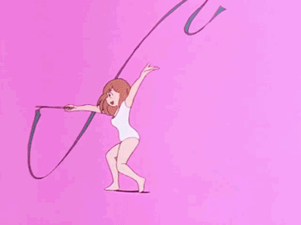
3
Apparatus
RIBBON
The stick has a 1 cm diameter and a length from 50 to 60 centimeters. It is usually made of wood, bamboo, plastic or fiber-glass. Most often the ribbon is made of satin or a similar material without starch. Its maximum weight is 35 grams, its width from 4 to 6 centimeters, and its length 6 meters at the minimum. This flexible, long, and light apparatus shapes patterns in space. Its aerial movements carve forms and images. The elements are performed in various amplitudes and rhythms. Snakes, spirals and throws represent the main elements in the use of the ribbon.
Rhythmic gymnastics Part 3

Slide 12
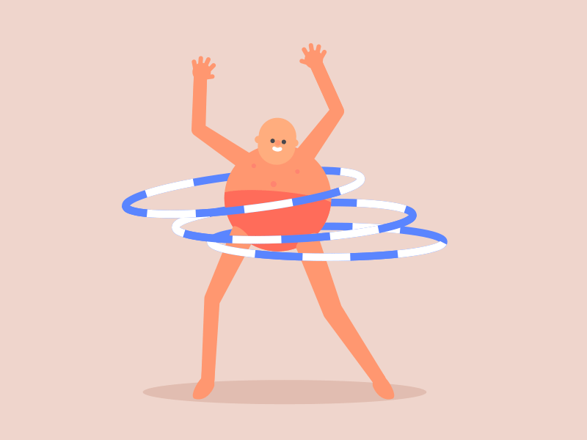
4
Apparatus
HOOP
The hoop may be of wood or plastic. Its interior diameter is from 80 to 90 centimeters; its minimum weight is 300 grams. It must be rigid enough to retain its shape. The hoop carves a space that must be fully used by the gymnast, as when she passes through the hoop or when the apparatus rotates around any part of her body. The frequent grip changes in the handling of the apparatus require strong coordination skills. The shape of the hoop is ideal for rolling and rotating the apparatus on the floor or on different parts of the body as well as for passing over or through it.
Rhythmic gymnastics Part 4

Slide 13
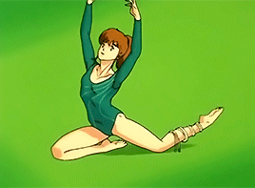
4
Apparatus
ROPE
The rope may be of hemp or synthetic material. Its length is in proportion to the size of the gymnast. Instead of a handle, each end of the rope terminates in a knot. The technical elements can be performed with the rope open or folded, held with one or both hands, with or without the rope changing hands. The relationship between the apparatus and the gymnast may evoke an aggressive image, as when the rope takes hold of the gymnast and wraps itself around her. But flexibility, agility, and gracefulness will always transcend this moment of “fury”.
Rhythmic gymnastics Part 4

Slide 14
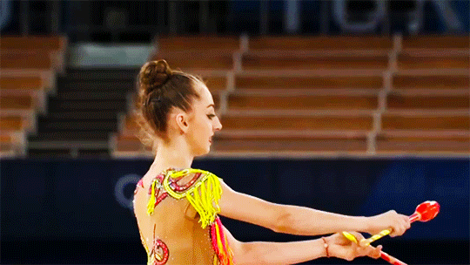
4
Apparatus
CLUBS
The clubs are another piece of equipment that rhythmic gymnasts use. The clubs look similar to bowling pins or bottles. They are made of wood or plastic. Gymnasts use the clubs to do circles, throws, swings, plus tapping.
Rhythmic gymnastics Part 4

Slide 15
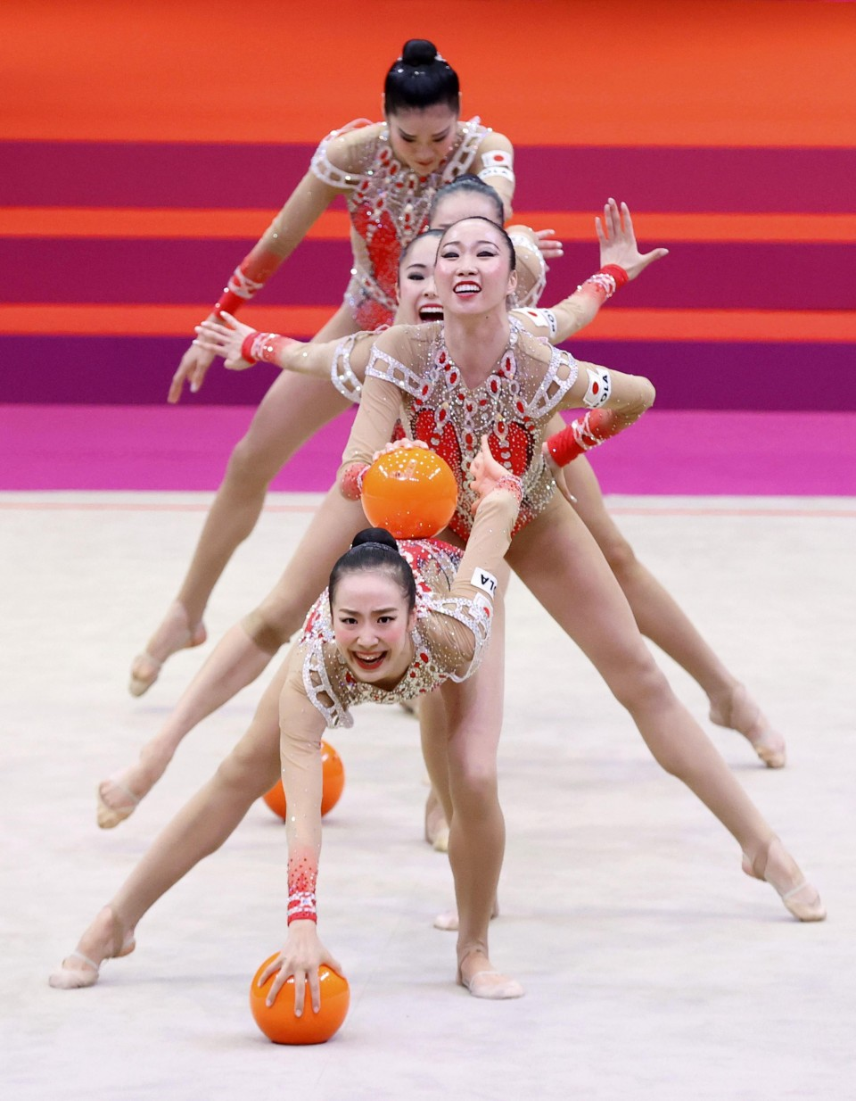
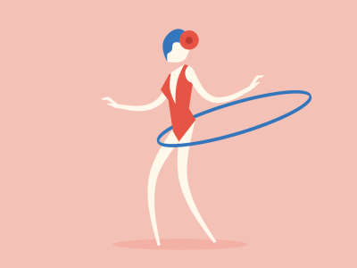
5
Rhythmic Gymnastics Routine
Rhythmic gymnastics routines also combines’ ballet, body skills and creative movements with music, while working with ribbons, balls, hoops, ropes and clubs in a choreographed dance-and-tumble routine. There are two different disciplines, individual and groups.
An individual gymnast competes with four different routines, using a different piece of apparatus and music for each of them.
Groups are made up of 5 gymnasts (+2 reserves) and they perform 2 routines. As for individual gymnasts it will depend on the Competition Criteria on which pieces of apparatus they use in their performances.
Rhythmic gymnastics Part 5

Slide 16

Thank you
For listening!
Sign In
100% Done
19+
PE 3
Sign Out
Questions? Clarifications FAQ About Us Help Center

